Slide 1
Csc advising system
Omar ali eissa
Diaa el den amine Ibrahim
Marwan Ayman Mohamed
Karem Gamal

Slide 2
Objectives
The main objective of this program is to provide a structured way to input and store student transcript data.

Slide 3
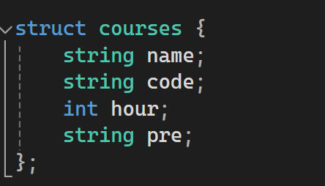
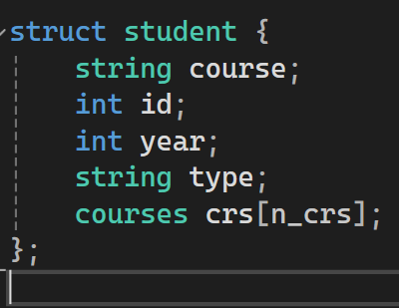
Two structs are defined: course and student.
The course struct stores information about a course, including its name, code, hours, and prerequisite.
The student struct stores information about a student, such as their name, ID, year, type, and an array of courses taken (crs).

Slide 4
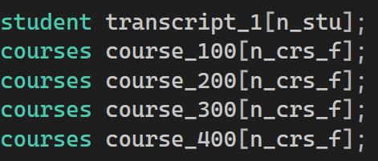
the provided code snippet declares arrays of structs student and courses with sizes determined by variables n_stu and n_crs_f. These arrays are likely intended to store information about students and courses in a larger program. However, the specifics of these arrays and the meaning of the variables used are not provided within this snippet.

Slide 5
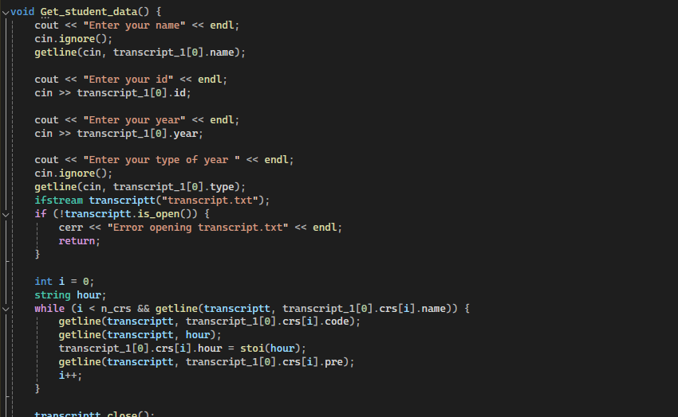
The function (Get_student_data) appears to be designed to read data from a file named transcript.txt and populate an array of course structures associated with a single student.

Slide 6
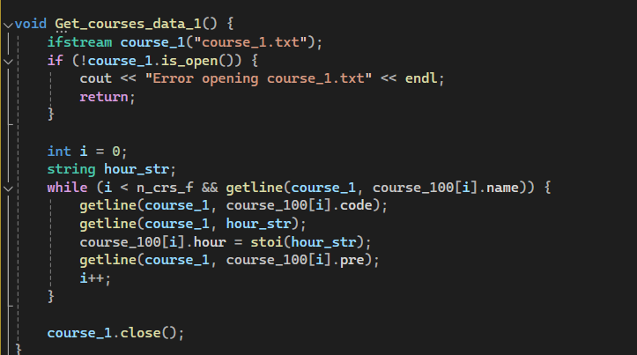
The function Get_courses_data_1 is designed to read course data from a file named course_1.txt and populate an array of course structures with this data.

Slide 7
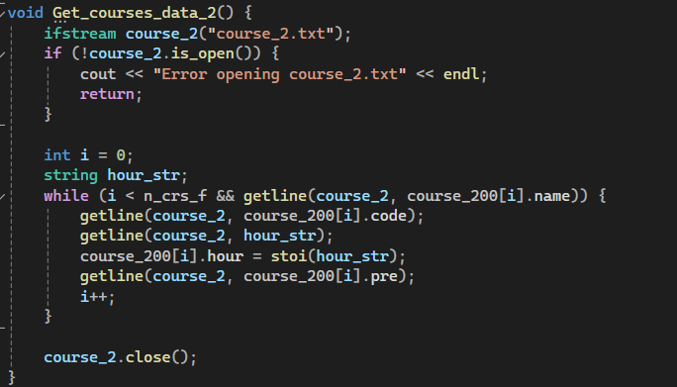
function Get_courses_data_2 is designed to read course data from a file named course_2.txt and populate an array of course structures with this data.

Slide 8
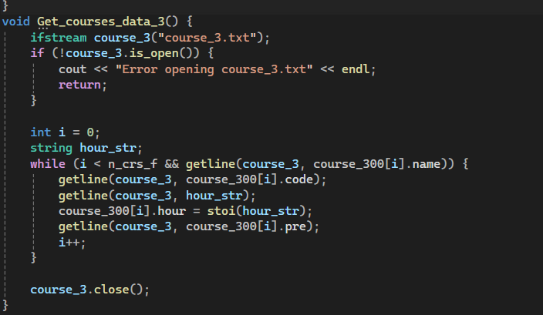
The function Get_courses_data_3 is designed to read course data from a file named course_3.txt and populate an array of course structures with this data.

Slide 9
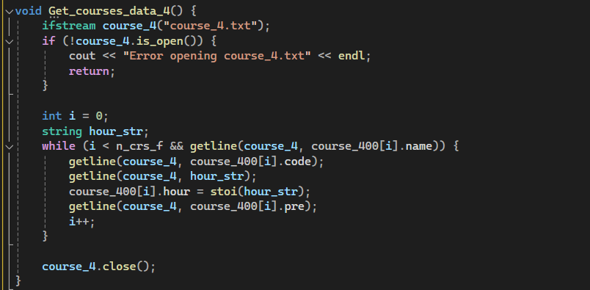
The function Get_courses_data_4 is designed to read course data from a file named course_4.txt and populate an array of course structures with this data.

Slide 10
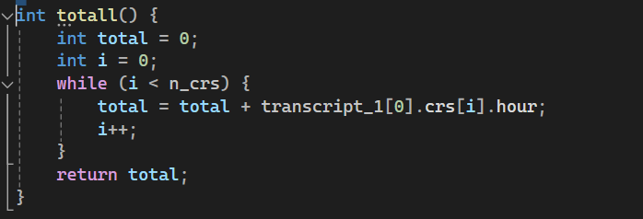
function calculates the total number of hours of courses taken by a student by iterating through their transcript and summing up the hours of each course. It's a simple and effective way to compute the total workload of a student.

Slide 11
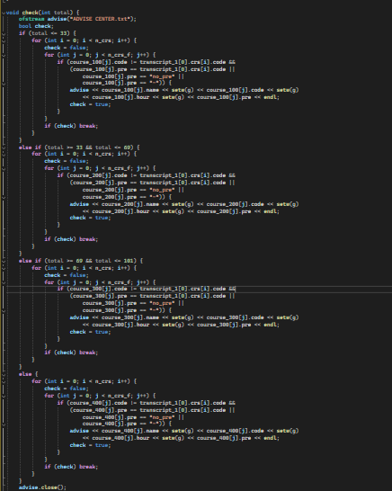
this function generates advisories for the student based on the total number of hours completed, suggesting potential courses for the student to take next. The generated advisories are written to a file named "ADVISE CENTER.txt".

Slide 12
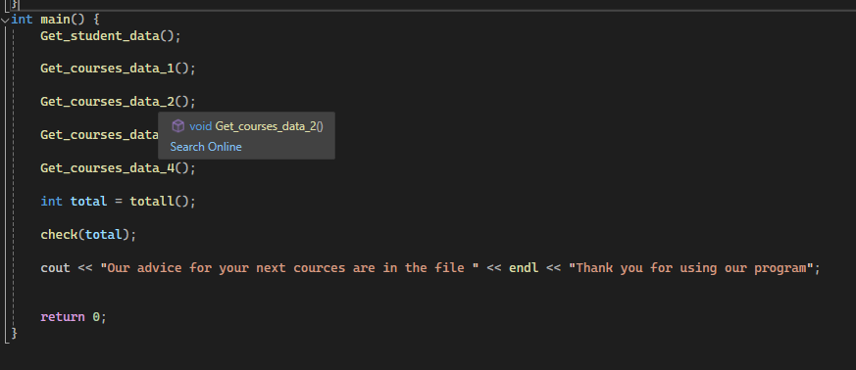
the main function initializes constants n_c (number of courses) and stu (number of students).
It declares an array transcript_1 of student structs with size stu.
Calls the geting_student_data function to populate data for the first student.
After obtaining the data, it attempts to open the "transcript.txt" file in append mode and writes the student and course information to it.

Slide 13
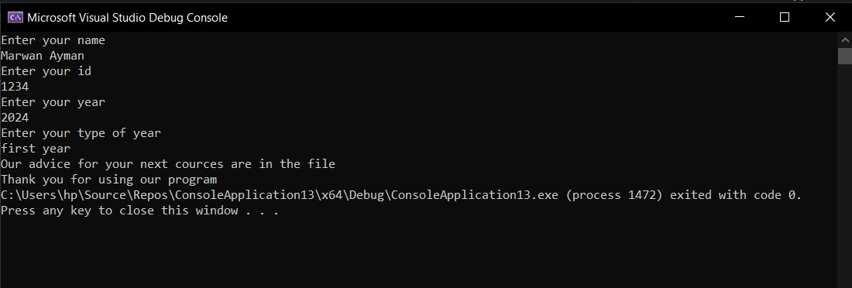
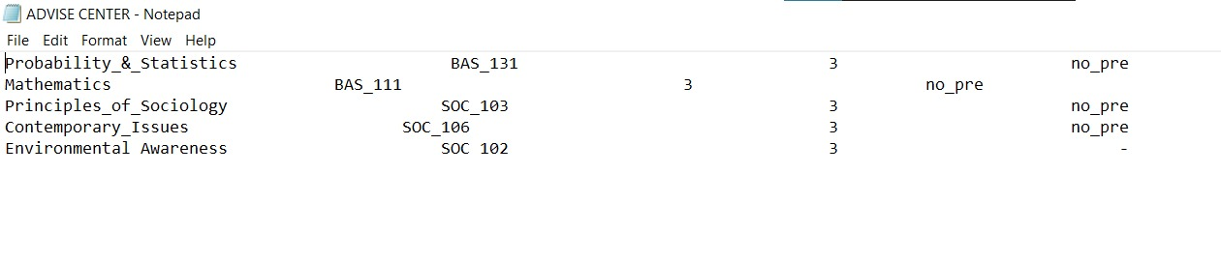
These photos are about what is shown up after we run our code the first one is the first thing that the user sees and the next one is about the file that we store the student's next semester courses and that's how our program work

Slide 14
THANK YOU

